Slide 1


CAMPUS CONNECT PROGRAM

Slide 2
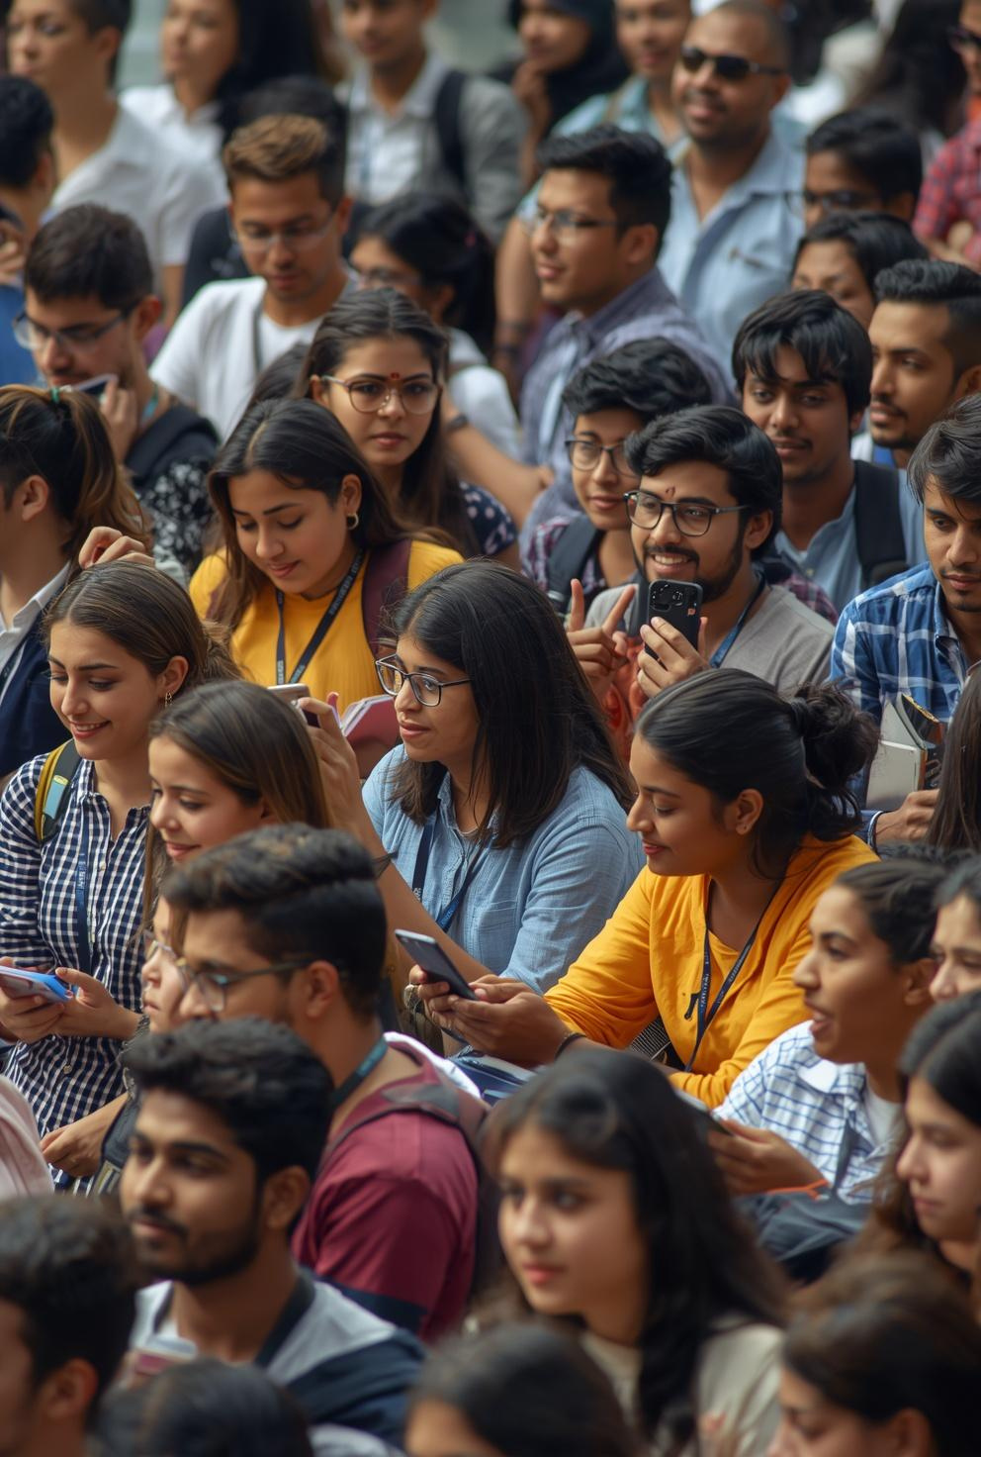


CAMPUS CONNECT
India’s Largest Youth Engagement Initiative
500+ Colleges
10 Elite Ambassadors
Pan India Program

Slide 3
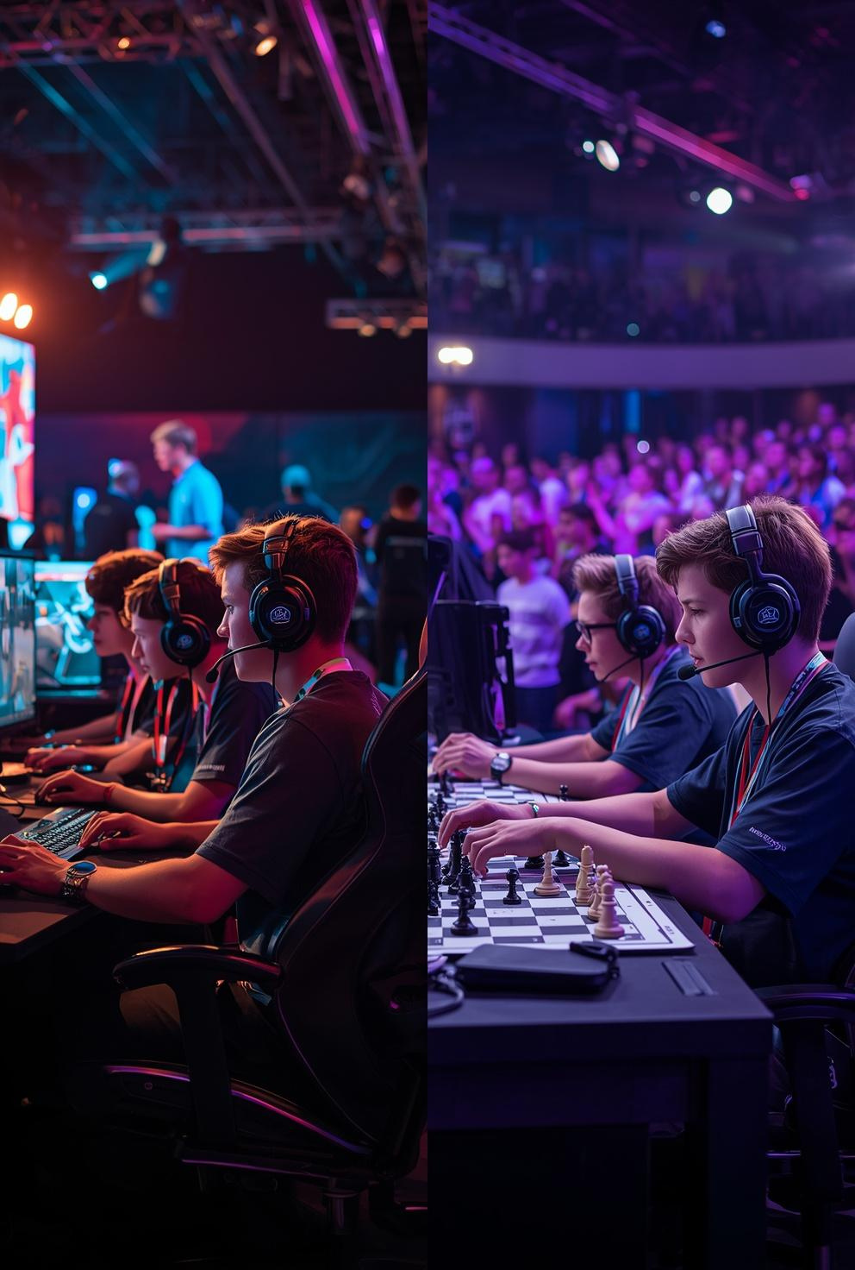


ABOUT PRIME ENGAGE
Youth-focused event & engagement company
Organizers of:
National Chess Championships
Esports Tournaments (BGMI & more)
Expertise in large-scale, multi-city events
Strong focus on community building & youth culture

Slide 4

PROGRAM VISION
To build a nationwide network of student leaders who drive:
Campus engagement
Event participation
Youth-led communities

Slide 5
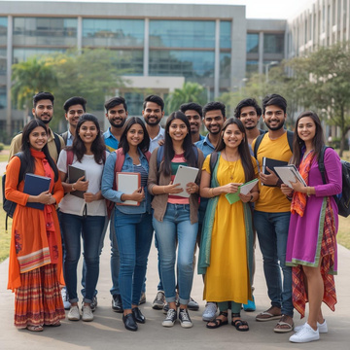



500+ COLLEGES
PROGRAM OBJECTIVE
TOP STUDENT LEADERS
Establish presence in 500+ colleges
Drive participation in national events
Identify top student leaders & creators
Build long-term campus partnerships
LONG TERM PARTNERSHIPS

Slide 6

LEADERSHIP
PROGRAM OVERVIEW
EXPOSURE
Nationwide ambassador program
Selection of Top 10 performers
Direct involvement in Prime Engage events
EARNINGS

Slide 7

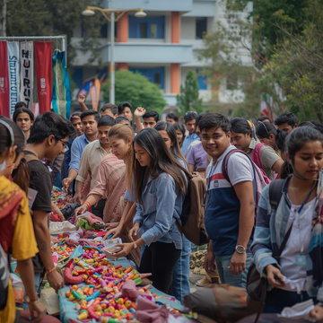

GAMING
WHO CAN APPLY
EVENTS
College students (any stream)
Passionate about:
Gaming
Events
Content creation
Strong communication & leadership skills
CONTENT CREATION

Slide 8
SELECTION PROCESS
Application submission
Shortlisting (based on profile & interest)
Interaction / evaluation
Final selection of Top 10 Ambassadors

Slide 9


ROLE OF CAMPUS AMBASSADOR
Represent Prime Engage in college
Promote events & drive registrations
Build campus community
Create digital content
Coordinate with college authorities

Slide 10
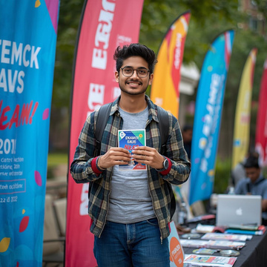
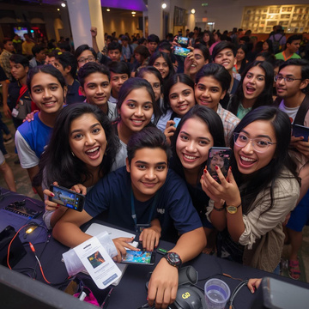
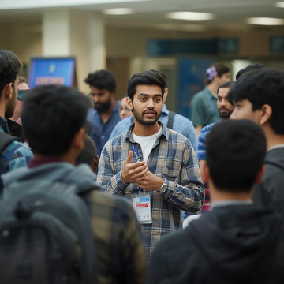
ON-GROUND PROMOTIONS
KEY RESPONSIBILITIES
DRIVE PARTICIPATION
Execute on-ground promotions
Drive participation for chess & esports events
Manage campus-level engagement
Act as a local point of contact
Support event execution (if required)
CAMPUS ENGAGEMENT

Slide 11
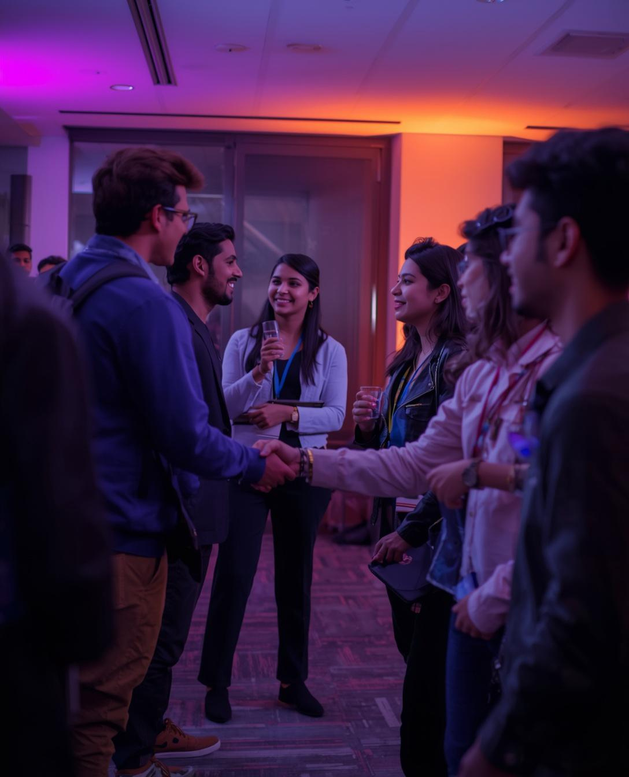
BENEFITS OVERVIEW
Why Join Campus Connect?
Financial incentives
Career opportunities
Networking exposure
Premium event access

Slide 12


EARNINGS OPPORTUNITY
₹5,000 - ₹50,000
PERFORMANCE BASED
₹5,000 – ₹50,000 incentives
Based on:
Performance
Event contribution
Opportunity to work on:
Chess Championships
Esports Events
EVENT REWARDS

Slide 13
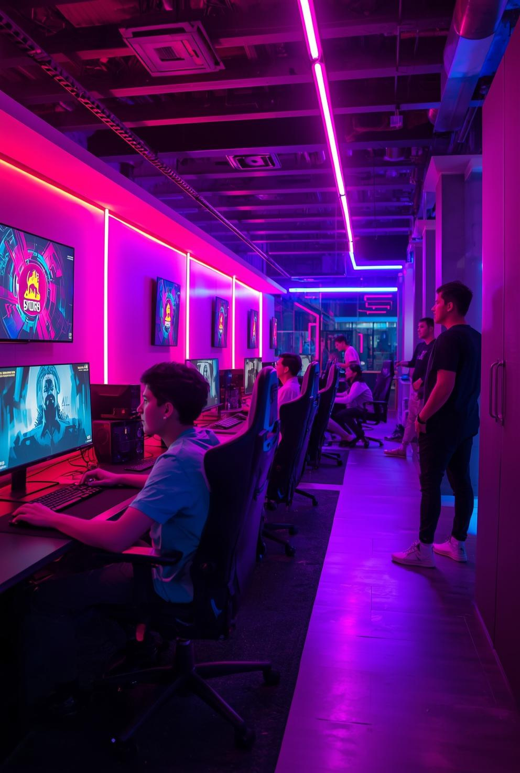

GAMING BENEFITS
Gaming Zone Vouchers
Access to city-based gaming venues
Exclusive gaming experiences

Slide 14


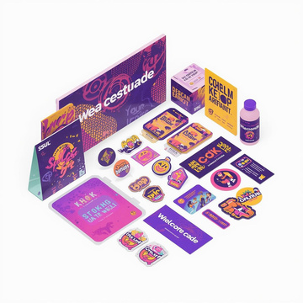
PRIME ENGAGE HOODIE
AMBASSADOR KIT
DIARY & NOTEBOOK
Prime Engage Hoodie
Diary & Notebook
Branded Merchandise
Welcome Kit
BRANDED MERCHANDISE

Slide 15
MARKETING
INTERNSHIP OPPORTUNITY
EVENT MANAGEMENT
3-Month Internship at Prime Engage
Exposure to:
Marketing
Event Management
Content Creation
CONTENT CREATION

Slide 16

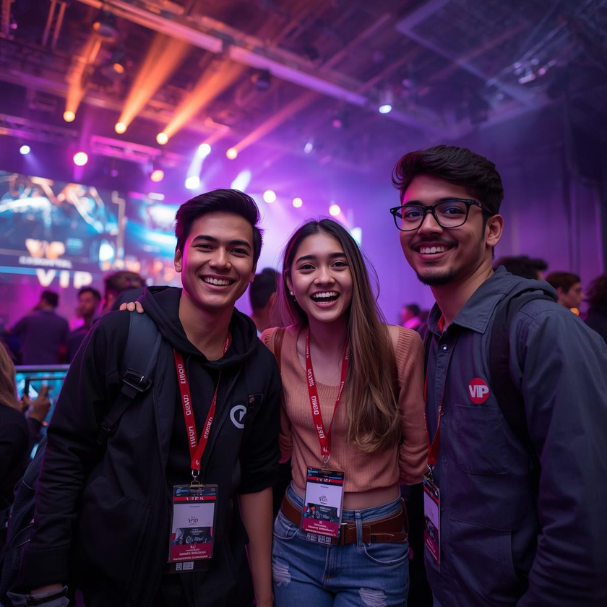
EXCLUSIVE ACCESS
VIP Event Passes
Behind-the-scenes exposure
Direct involvement in major events

Slide 17
COLLEGE COLLABORATION
Bring your college onboard
Enable sponsorship opportunities
Fest collaborations & activations

Slide 18


INDUSTRY EXPOSURE
Invitations to:
Industry Leader Meets
Networking events
Build connections with professionals

Slide 19

CONTENT & MEDIA EXPOSURE
Feature in:
Podcasts
Social media campaigns
Opportunity to grow as a content creator

Slide 20

GROWTH & IMPACT
Build leadership skills
Strengthen resume
Create personal brand
Gain real-world experience
BUILD LEADERSHIP
STRENGTHEN RESUME
PERSONAL BRAND
REAL EXPERIENCE

Slide 21

PERFORMANCE METRICS
Ambassadors will be evaluated on:
Registrations driven
Engagement created
Content output
Event participation
REGISTRATIONS
ENGAGEMENT
CONTENT
PARTICIPATION

Slide 22


RECOGNITION
Top performers get:
Higher incentives
Priority internship roles
National-level exposure

Slide 23
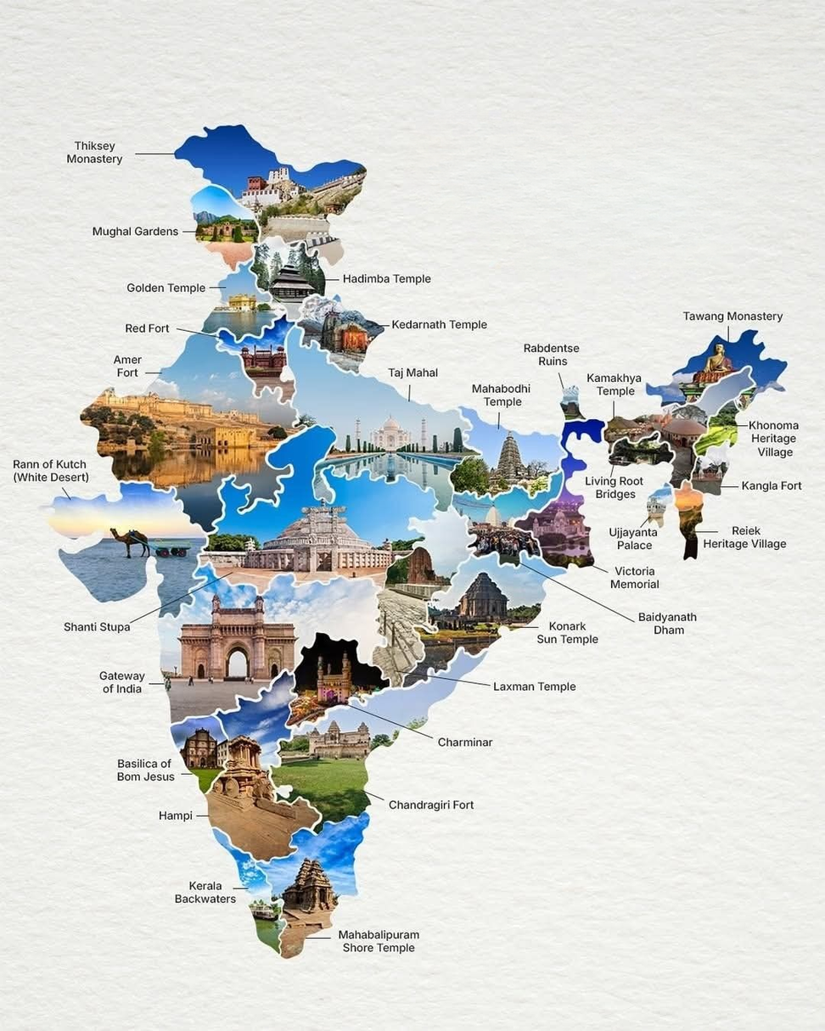
PROGRAM REACH
500+ Colleges
Multi-city activation
Pan India impact

Slide 24
TIMELINE
Applications Open
Shortlisting
Final Selection
Program Execution

Slide 25

APPLY NOW! LIMITED TO 10 AMBASSADORS
Be Part of India's Fastest-Growing Youth Network

